Slide 1
Other tools

Slide 2
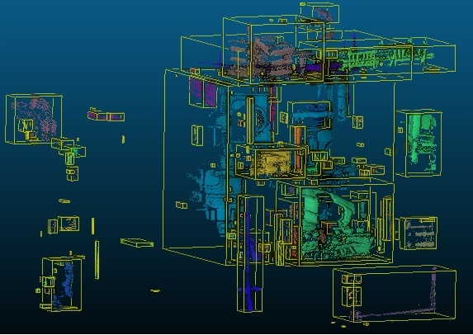
Cleaning
Several methods available:
Interactive segmentation
Connected components extraction
(Tools > Segmentation
> Label Connected Comp.)
Noise removal:
  Tools > Clean > SOR filter
  Tools > Clean > Noise filter
Other option: thresholding based on a scalar field values (roughness, etc.)

Slide 3
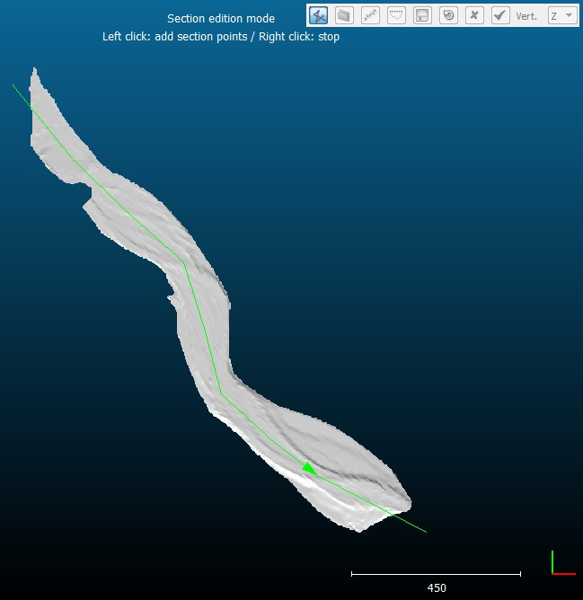
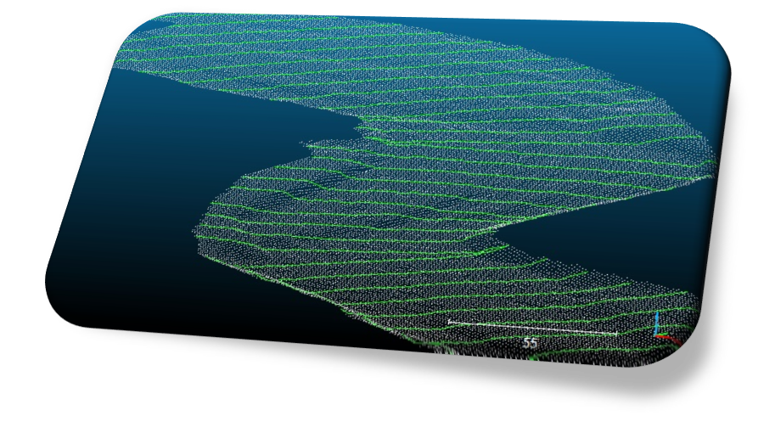
Profile extraction
Tools > Segmentation > Extract sections

Slide 4
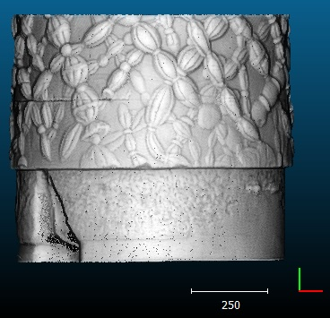
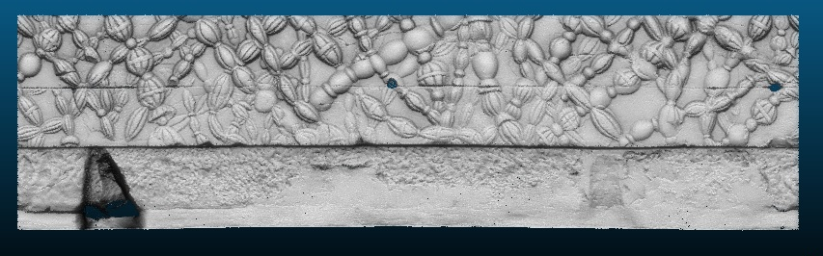
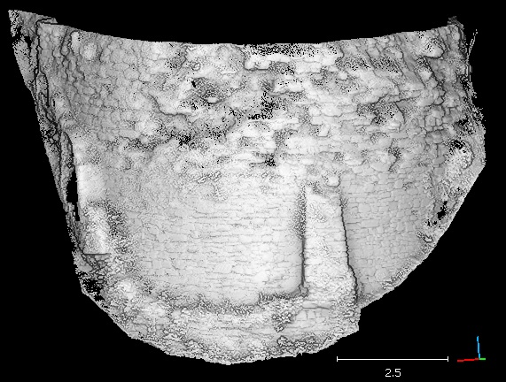
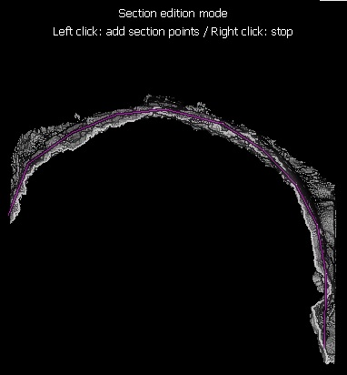
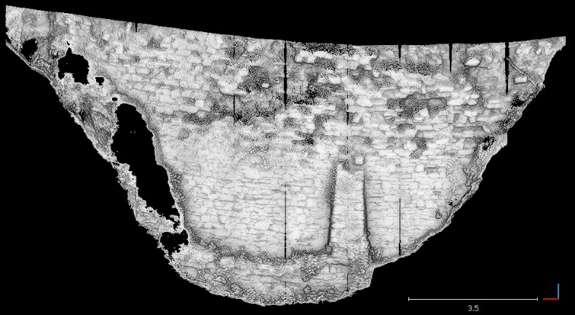
Unrolling
  Cylindrical or conical unrolling (Tools > Projection > Unroll)
Profile based unrolling (Section Extraction tool – version 2.6.3+)

Slide 5
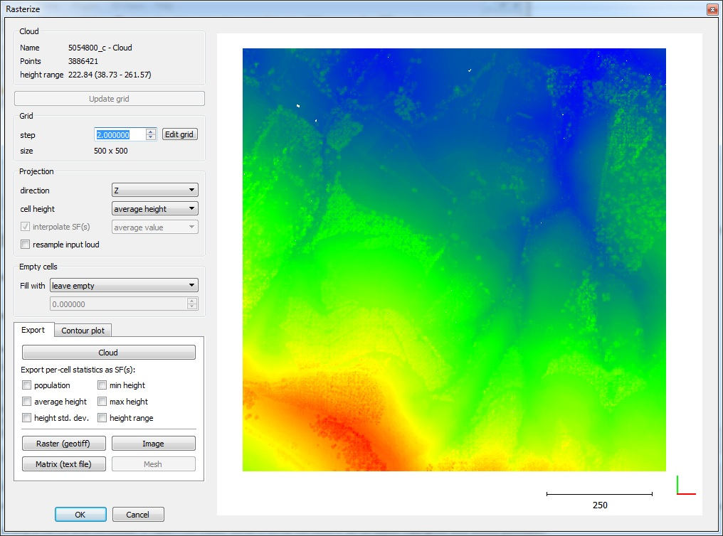
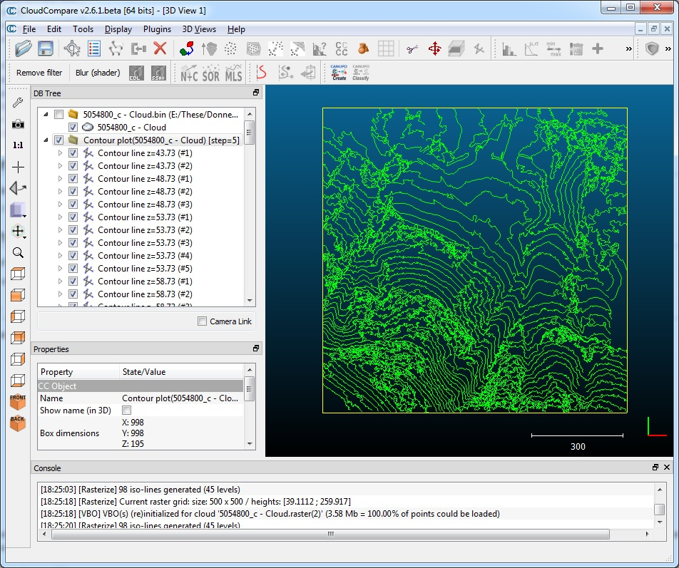
Raster and contour plot

Slide 6
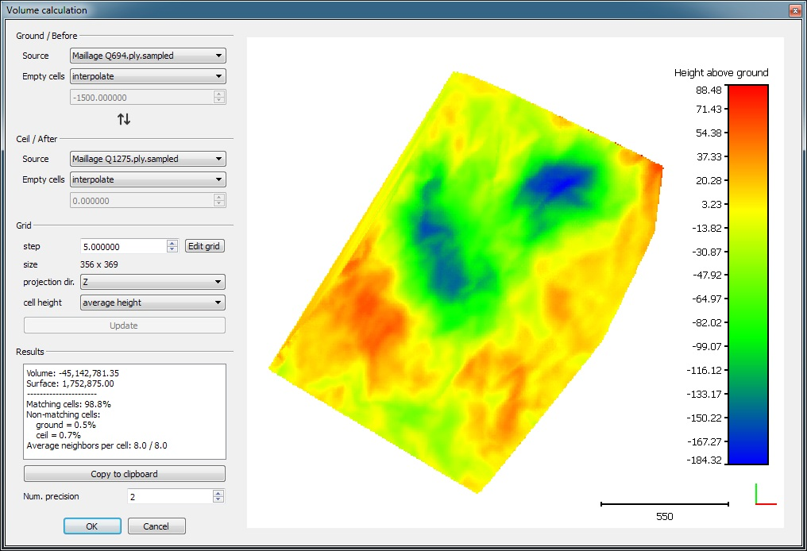
Volume estimation (2.5D)
Estimation of volume differences between two clouds projected along X, Y or Z (Tools > Volume > Compute 2.5D volume)

